Slide 1

Runtime Terrors Project name: - Wizard-The Mind Reader
Team Members
➢ Utkarsh Gumphekar
➢ Suryansh Trivedi
➢ Sankalp Patel
➢ Shivansh Pratap

Slide 2
Introduction
This is an android platform based project. It is a entertainment / fun based category app. The application is a prediction oriented game which focuses on guessing the entity by using a simple questionnaire and thus it will predict about what the user is thinking!!!
The product will have a interactive voice based interface, the user will answer the questions in a voice based environment. The user will give instructions to the prediction telling wizard .Which will guide the user throughout the game.
The future objective is to train the voice feedback of the game to give an informative output in form of voice so that this application can be used for fun and education purpose.

Slide 3
Objective
This Project aims its objectives to multiple foregrounds namely Fun, Entertainment and Education through one app digitally. The application is to provide a gaming environment to the user whilst checking his/her knowledge also. The knowledge will be tested as the application asks you several question about what you want the application to predict, so in this way the information of user is also tested and increasing through the application.
The Main task of the application is to predict that what the user is thinking about and this is done by asking related questions which are logically made to converge to the right guess hopefully!!
Interface and voice input commands and voice interaction from the user interface of the game is also attractive and engrossing.
The future objective is to train the voice feedback of the game to give an informative output in form of voice so that this application can be used for fun and education purpose. 4 Scope The application scope l

Slide 4
Scope
The application scope lies in the field of fun and leaning simultaneously.The targeted audience of our application is anybody (Age 5+) who knows how to use a mobile app and speak and interact with a bot in our application and can answer in yes/no etc. commands.
Why anybody will use a game application….which just interacts?? Here’s why:
· The application is a entertaining and engrossing.
· The app is fun yet informative.
· This application not only gives you a feel of mind reading but also improves your memory and learning abilities.
· It will provide user a fun experience in this modern hectic work schedules.
· It is a great app for parties and other group events.

Slide 5
Features
ØUser and interaction based
ØPrediction oriented approach
ØVoice based interactive User interface
ØPlaying and learning in more comprehensive way
ØMind reader application
ØMultilevel Priorities and severities
ØIt contains better storage capacity
ØAccuracy in work
ØEasy and fast retrieval of information
ØWell-designed data structures
ØUse of complex algorithms and techniques.
ØFun and learning together in one app
ØEasy to update information
ØAccess of any information individually
ØLearning information about new fields
ØRobust database backend
ØGives wholesome information about the guessed answer ØUse of complex searching and sorting operations

Slide 6
Technologies-Used
1.Android Studio
2. Firebase
3. IBM cloud services
4. Cognitive services and API’s
5. Adobe XD

Slide 7
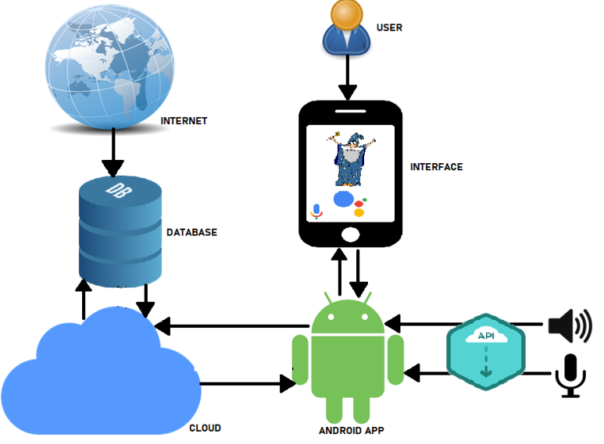
Flow Diagram
User
Interface Application
Android
API (Speech to text/ Text to speech)
Cloud
Database
Internet (Live Database)

Slide 8
Market Potential and Future Updates
The application focuses on entertainment and gaming category and market reports on various app stores like google play store etc. have top trending apps as of entertainment category so the potential of the application has strong market to grow into and establish its root into the Indian as well as the global market.
The application after establishing the roots into the app market the developers of the team would release regular updates as:
ØRegular updates of the categories in the application.
ØMaintaining and optimizing database and application interface.
ØNew Fun and learning updates dedicated for learning with the Wizard character in the game

Slide 9
Conclusion
Our application is a simple yet fascinating gaming project. The idea of the game is based on old time practices of mind reading and guessing. The application is designed and optimized in such a way that it will predict with high accuracy.
The application is a fun and learning app and also provide a chilling environment, the application is based on voice recognition and voice synthesis technologies.
And we as a team will always be engaged in upgrading and updating app for its growth and making the user experience better…….

Slide 10
Thank You!!
For Viewing Our Presentation

